Slide 2
ELECTION OUTCOME PREDICTION USING SOCIAL MEDIA ANALYSIS
MEMBER’S NAME | ROLL NUMBER | SAP ID | BRANCH
Aditya Aditya | R214220080 | 500084655 | Big Data
Ali Amaan Zaidi | R2142201365 | 500085037 | Big Data
Ayush Upadhyay | R214220324 | 500083050 | Big Data
Raghav Parashar | R214220894 | 500084199 | Big Data
Under the guidance of:
Dr. Kingshuk Srivastava
(School of Computer Science)

Slide 3
CONTENTS
Introduction
Abstract
Motivation
Literature Review
Problem Statement
Objective
Methodology
References
Pert Chart

Slide 4
INTRODUCTION
The use of social media analysis to predict the outcome of general elections has gained significant attention in recent times. With the massive growth of social media platforms, political parties and candidates have been able to reach out to a wider audience, engage with them, and influence their voting behaviour
As a result, social media has become an essential tool for political campaigns .Social media analysis is a powerful technique that can be used to gather insights about voter behaviour, opinions, and preferences. It involves the collection and analysis of social media data such as tweets, posts, comments, and likes, using various tools and algorithms.
The accuracy of election outcome prediction using social media analysis depends on the quality of data collected and the methods used for analysis. However, social media analysis can provide valuable insights into voter behaviour and preferences, which can be used to inform political campaigns and shape their strategies.

Slide 5
ABSTRACT
General election outcome prediction using social media analysis is necessary due to several reasons. One of the primary reasons is that social media has become an integral part of our lives, and people tend to share their opinions and thoughts about politics and elections on these platforms.
These opinions and thoughts can provide valuable insights into the sentiments and preferences of the voters, which can help in predicting the election outcome accurately. Moreover, social media platforms are also being used by political parties and candidates to promote their campaigns and reach out to voters.
By analyzing the social media activities of these parties and candidates, it is possible to assess their popularity and influence, which can aid in predicting the election outcome.

Slide 6
MOTIVATION
The team wanted to build a project related to Natural Language processing. It is one of the most important aspect related to machine learning.
We decided to proceed with Election Prediction as Social Media plays a huge role in political scene nowadays.
We planned to use Sentiment analysis to analyze political posts and other forms of political discourse.

Slide 7
LITERATURE REVIEW
https://arxiv.org/pdf/1706.00188v1.pdf
2. https://www.researchgate.net/publication/318368881_Sentiment_Analysis_Machine_Learning_Approach
3. https://www.hindawi.com/journals/sp/2022/2681533/
4. https://www.sciencegate.app/document/10.1109/tla.2022.9667151

Slide 8
PROBLEM STATEMENT
Social Media plays an important role in politics nowadays. By analysing social media trends we can get an idea of the outcome of political elections.

Slide 9
OBJECTIVE
To understand the sentiments of the general public towards different political parties and candidates.
To use sentiment analysis as a tool to predict the outcomes of an election by analyzing the collective mood of voters.
To gauge the popularity of different candidates among different sections of the society.
To provide political campaigns and candidates with real-time feedback on how their messaging and campaign strategies are resonating with voters.

Slide 10
METHODOLOGY
To fulfill the above stated objectives, we used the following tools:
Reddit API,Web Scraping Libraries.
NLP libraries and models
Code in PyCharm environment

Slide 11
REFERENCES
https://towardsdatascience.com/sentiment-analysis-concept-analysis-and-applications-6c94d6f58c17
https://brand24.com/blog/sentiment-analysis/
https://realpython.com/api-integration-in-python/
https://towardsdatascience.com/quick-fire-guide-to-apis-in-python-891dd98c8877

Slide 12
PERT CHART

Slide 13
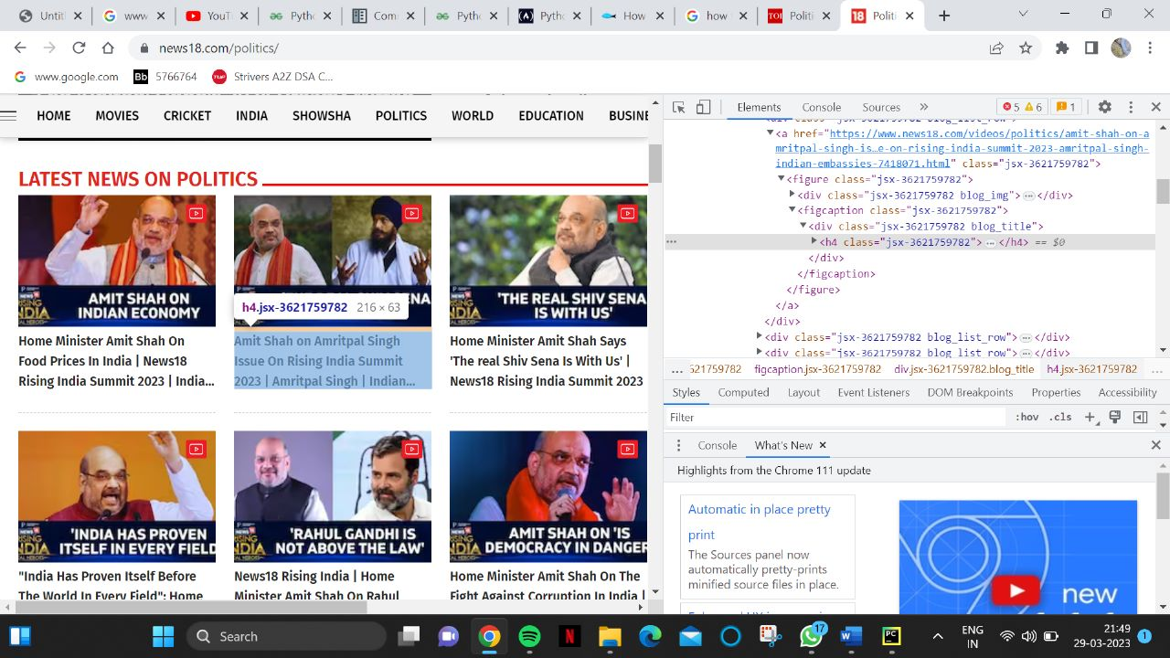
Code:
News 18:

Slide 14
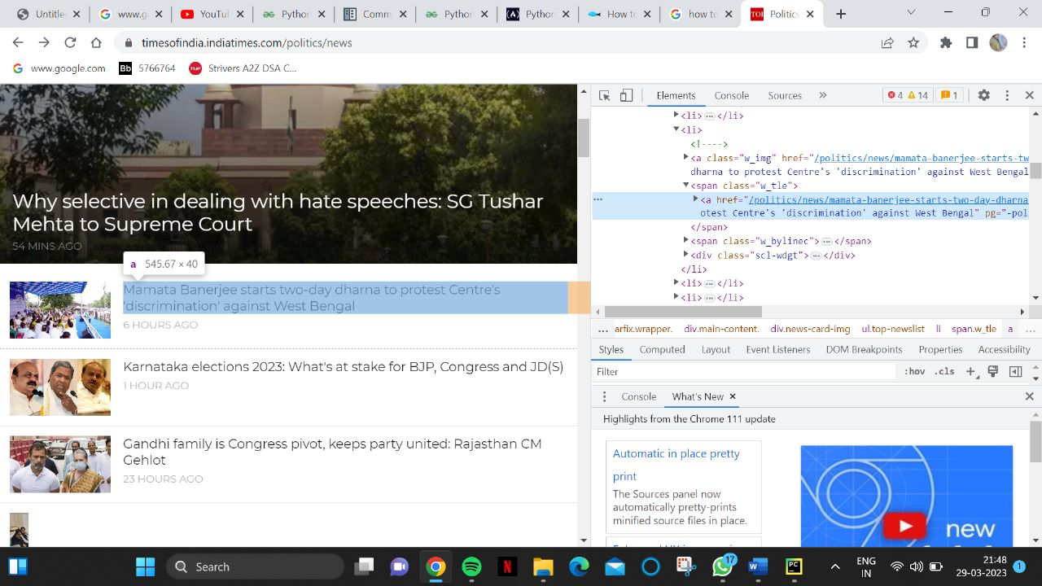
Times of India :

Slide 15
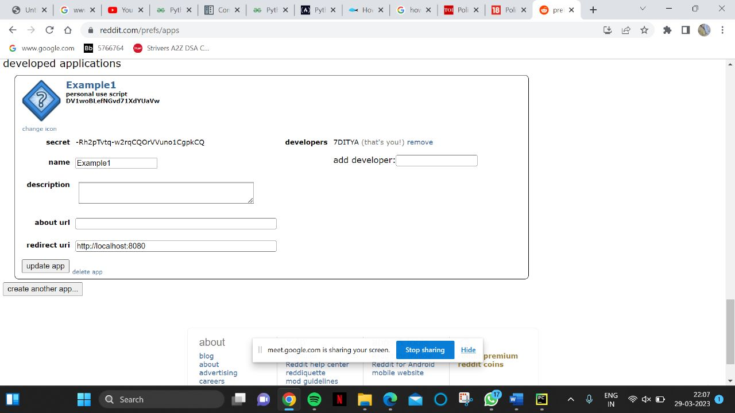
Reddit:

Slide 16
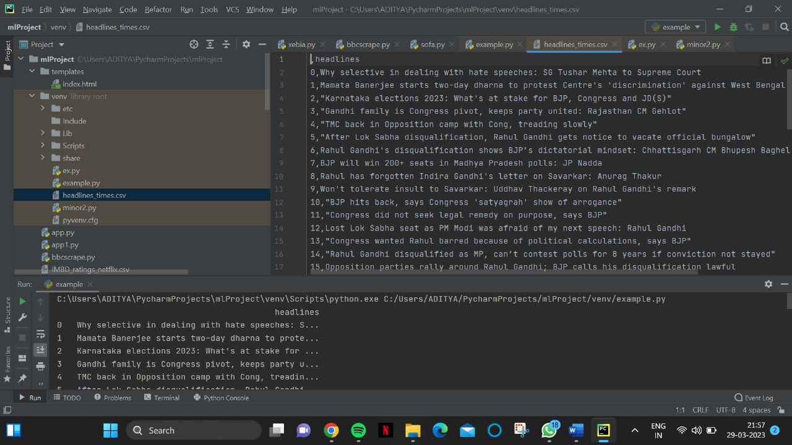

Slide 17
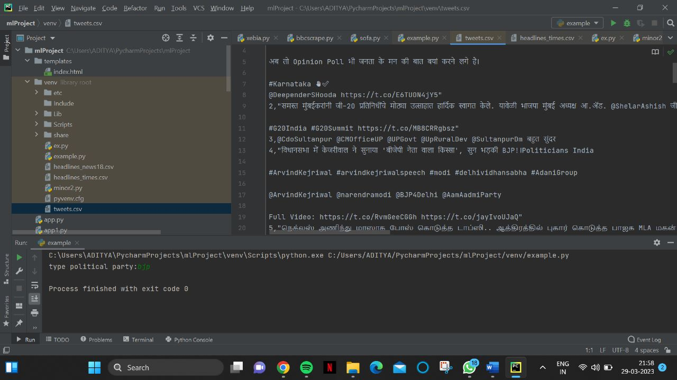

Slide 18
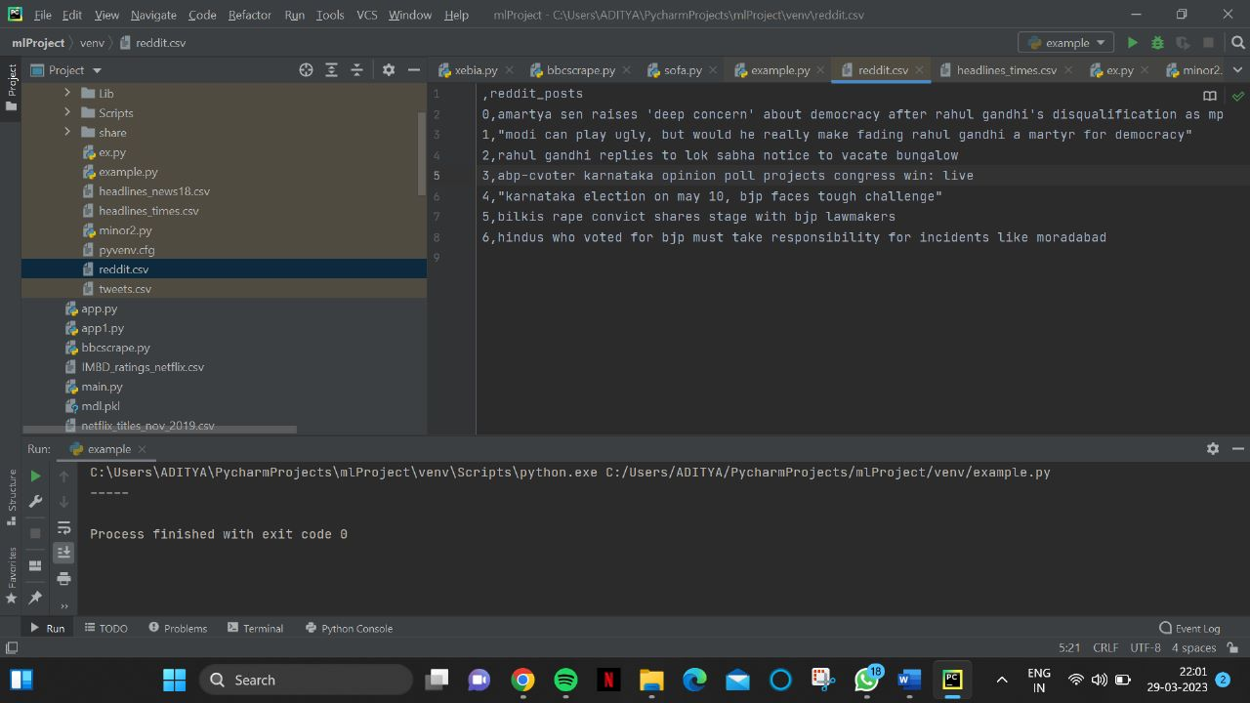

Slide 19
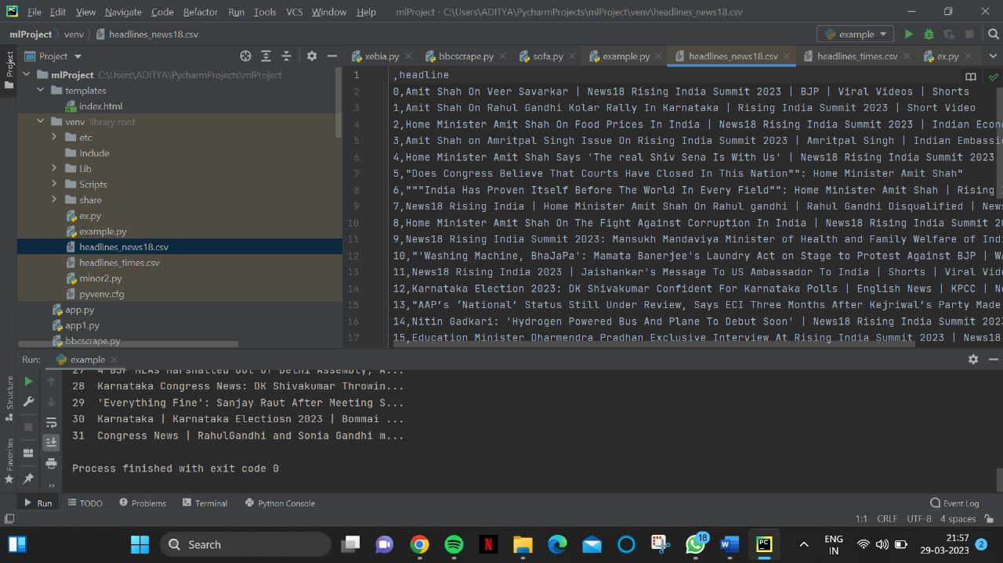

Slide 20
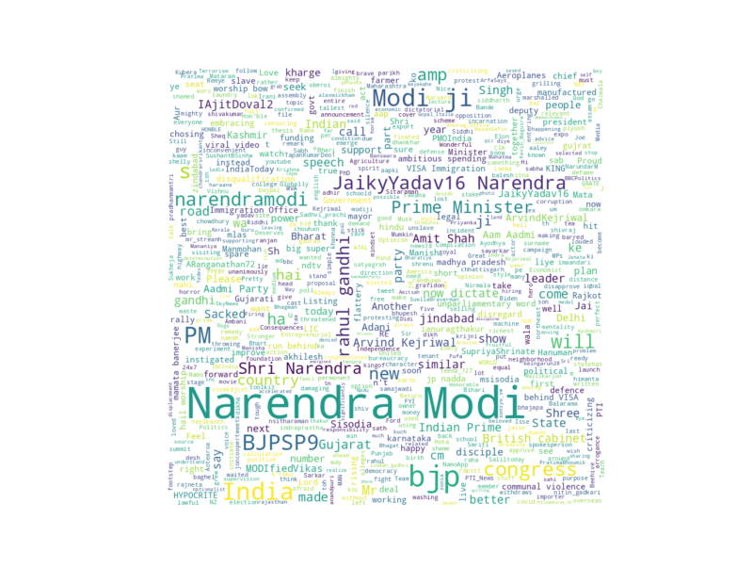
Word Cloud BJP

Slide 21
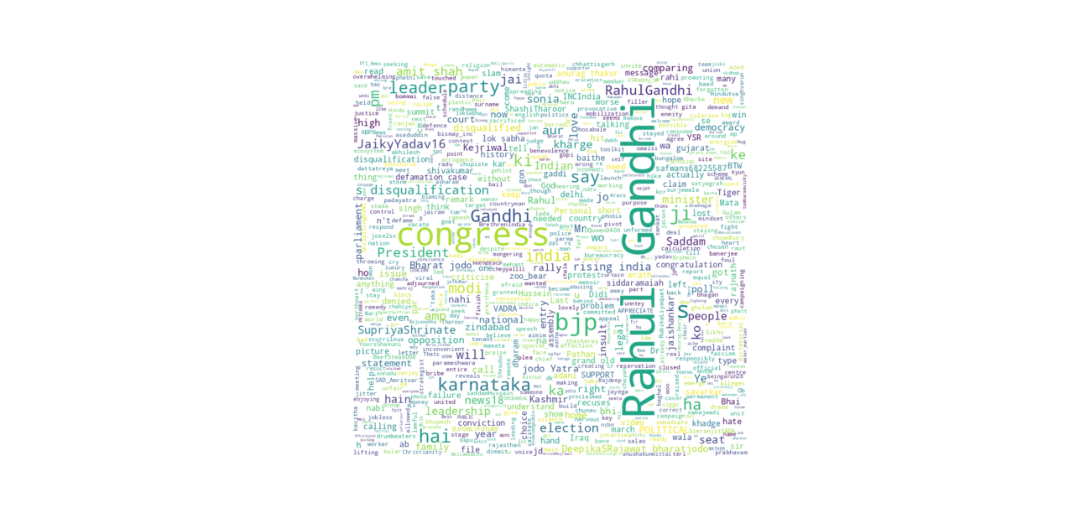
Word Cloud Congress

Slide 22
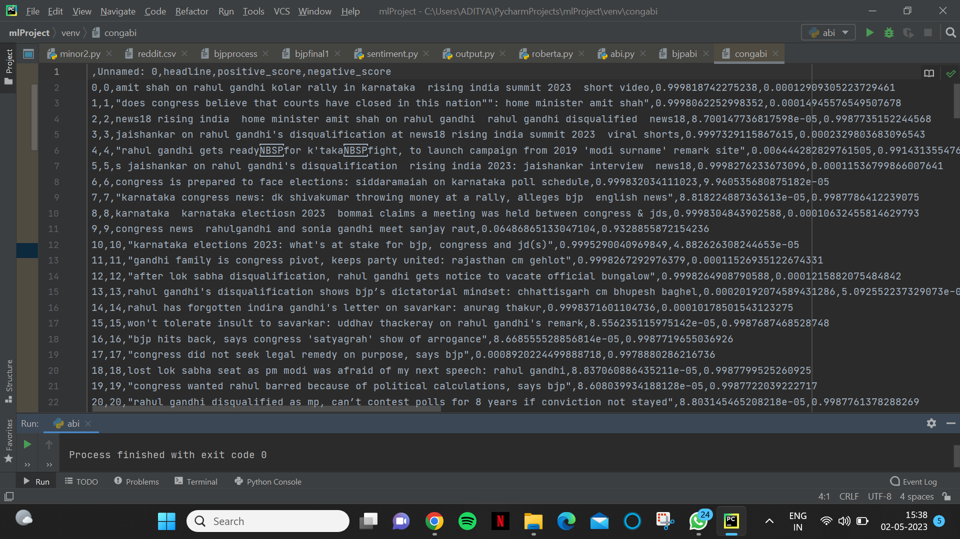
BJP Positive and Negative Score by Hinglish Model

Slide 23
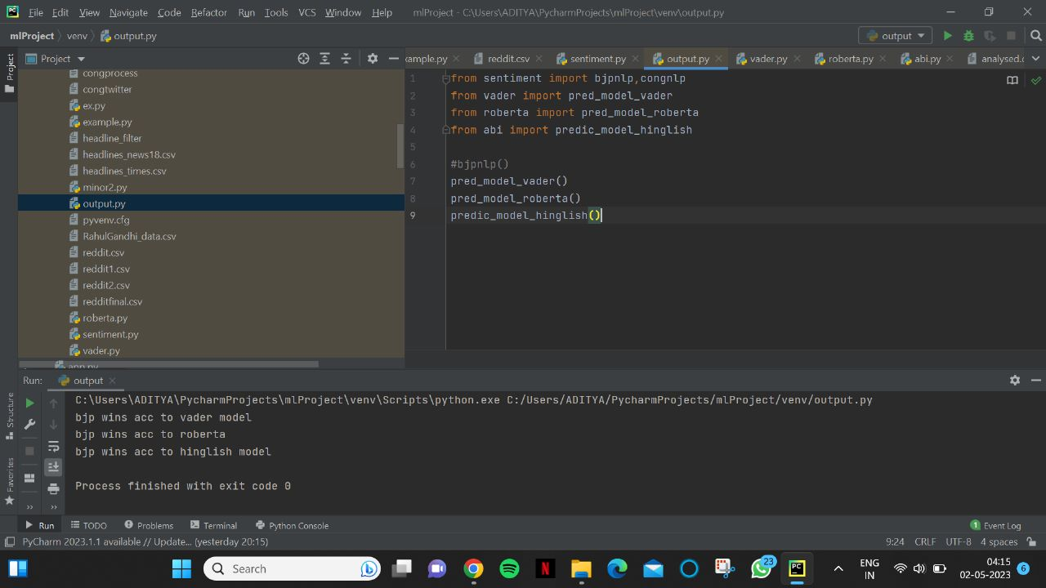
FINAL OUTPUT

